Slide 1
Lecture 06
Semantic Analysis:
Symbol Table & Scope Checking

Slide 2
Outline
Semantic Analysis
Overview of Semantic Analysis
Attributes and Attribute Grammars
Dependency Graphs and Algorithms for Attribute Computation
Symbol Table and Scope Checking
Type Checking for Semantic Analysis of a Program

Slide 3
Symbol Table
The data structure that is created and maintained by the compilers for information storing regarding the occurrence of various entities like names of variables, functions, objects, classes

Slide 4
Symbol Table
A symbol table may serve the following purposes depending upon the language in hand
To store the names of all entities in a structured form at one place
To verify if a variable has been declared
Type checking: verifying assignments and expressions in the source code are semantically correct
To determine the scope of a name (scope resolution)
Code Generation: generating call instructions based on the storage location of the function.

Slide 5
Symbol Table
The following possible information about identifiers are stored in symbol table
The name (as a string)
Attribute: Variable name, Procedure name, Constant name
The data type
The block level
Its scope (global, local, or parameter)
Location in memory

Slide 6
Symbol Table
Implementation
Symbol table can be mostly implemented as Hash table
The source code symbol itself is treated as a key for the hash function
the return value is the information about the symbol.
Entry format
A symbol table maintains an entry for each name, usually in the following format:
<symbol name, type, attribute>

Slide 7
Example :Declaration part of a program
CONST
A : Integer = 35;
B : Real = 49.0;
VAR
C : char;
PROCEDURE Add;
VAR G : Integer
Name | Kind | Data Type | value | scope | location | size
A | Constant | Integer | 35 | Lev | DX+offset1 | 4
B | Constant | Real | 49.0 | Lev | DX+offset2 | 8
C | Variable | char | -- | Lev | DX+offset3 | 1
Add | PROCEDURE |  | -- | Lev | BP | 4
G | Variable | Integer | -- | Lev+1 | BP+offset4 | 4

Slide 8
The entries in the symbol table might look like this:
struct SymbolEntry {
std::string name;
std::string type;
std::string scope;
std::string segment;
int offset;
int size; };
SymbolEntry entryName = {
.name = “A",
.type = "int",
.scope = "GLOBAL",
.segment = ".data",
.offset = 0x1000,
.size = 4
};

Slide 9
Or like this:
ConstantEntry consEntry = {
.name = “A",
.type = "int",
.value = 35,
.scope = GLOBAL,
.storageLocation = { .segment = "data", .offset = 0x1000 }
};
FunctionEntry funEntry = {
.name = "Add",
.returnType = "int",
.parameters = { { .name = "a", .type = "int" }, { .name = "b", .type = "int" } },
.scope = GLOBAL,
.address = { .segment = "code", .offset = 0x1234 }
};

Slide 10
Symbol Table
Typical operations
insert
used to store the information provided by name declarations when processing these declarations
more frequently used during analysis phase where tokens are identified
takes the symbol and its attributes as arguments
delete
remove the information provided by a declaration when that declaration no longer applies

Slide 11
Symbol Table
Typical operations
search(lookup)
used to search a name in the symbol table to determine:
if the symbol exists in the table.
if it is declared before it is being used.
if the name is used in the scope.
if the symbol is initialized.
if the symbol declared multiple times.

Slide 12
Symbol Table
The timing of when identifiers are recorded in the symbol table
Identifiers are entered into the symbol table, typically not during the Lexical Analysis phase.
During the Syntax Analysis and Semantic Analysis phases, construct the Abstract Syntax Tree (AST), check semantic correctness, and insert identifiers along with their associated information into the symbol table.

Slide 13
Scope Management
In programming languages, scope defines the visibility and lifetime of identifiers.
How do we keep track of what's visible?

Slide 14
Scope Management
Static Scope and Dynamic Scope
Static scope (lexical scope, will be discussed in our class
The scope of variables being determined at compile time.
The visibility of variables is based on their position in the source code.
The nesting levels of scopes are clearly defined at compile time.
Dynamic Scope
the scope of variables being determined at runtime
The visibility of variables is based on the current state of the call stack.
The nesting levels of scopes are dynamically determined at runtime.

Slide 15
// A C program to demonstrate static scoping.
#include<stdio.h>
int x = 10;
// Called by g()
int f(){
return x;
}
// g() has its own variable named as x and calls f()
int g(){
int x = 20;
return f();
}
int main(){
printf(“%d”, g()); //x=10
printf("\n");
return 0;
}

Slide 16
Scopes
Scope rules in programming languages vary widely.
Two common rules
declaration before use
Nested scope

Slide 17
Nested Scope
Block structure
A block is any construct that can contains declarations
A language is block structured
If the nesting blocks inside other blocks is permitted
If the scope of declarations in a block is limited to that block and other blocks nested in that block
Most-closely nested rule for blocks
Given several different declarations for the same name, the declaration that applies to a reference is the one in the most closely nested block to the reference.

Slide 18
Nested Scope
int value = 10;
void pro1(){
int one_1; int one_2;
{
int one_3; int one_4;
} // inner scope 1
int one_5;
{
int one_6; int one_7;
} //inner scope 2
}
void pro2(){
int two_1; int two_2;
{
int two_3; int two_4;
} //inner scope 3
int two_5;
}
inner scope 1
inner scope 2
inner scope 3

Slide 19
Nested Scope
Most-closely nested rule for blocks
Given several different declarations for the same name, the declaration that applies to a reference is the one in the most closely nested block to the reference.
Most-closely nested rule for blocks can be implemented by chaining symbol tables.
Chaining symbol tables is a static structure
Each scope stores a pointer to its parents, but not vice-versa
From any point in the program, symbol table appears to be a stack.

Slide 20
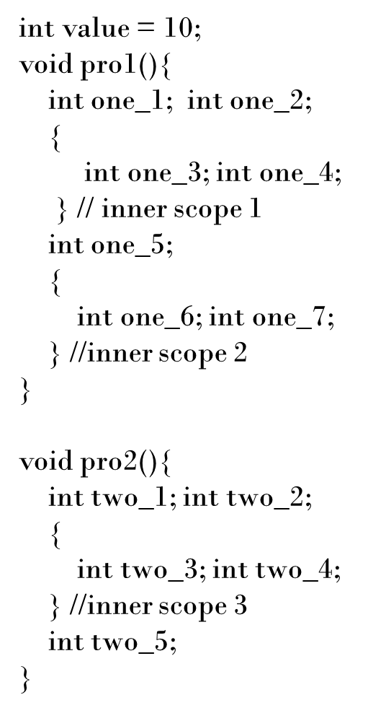
Nested Scope
value | var | int
pro1 | pro | --
pro2 | pro | --
one_1 | var | int
one_2 | var | int
one_5 | var | int
two_1 | var | int
two_2 | var | int
two_5 | var | int
one_3 | var | int
one_4 | var | int
one_6 | var | int
one_7 | var | int
two_3 | var | int
two_4 | var | int

Slide 21
Nested Scope
Typical operations for chaining symbol tables.
create a symbol table with its parent symbol table as parameter.
Enter a new scope.
Add all variable declarations to the symbol table.
Process the body of the block/function/class.
Exit the scope.
lookup a symbol.

Slide 22
Checking Scope rules
class Foo {
int value;
int test() {
int b =3;
return value +b;
}
void setValue(int c) {
value = c;
{
int d = c;
c = c + d;
value = c;
}
}
}
scope
of b
scope
of value
block1
scope
of d
scope
of c

Slide 23
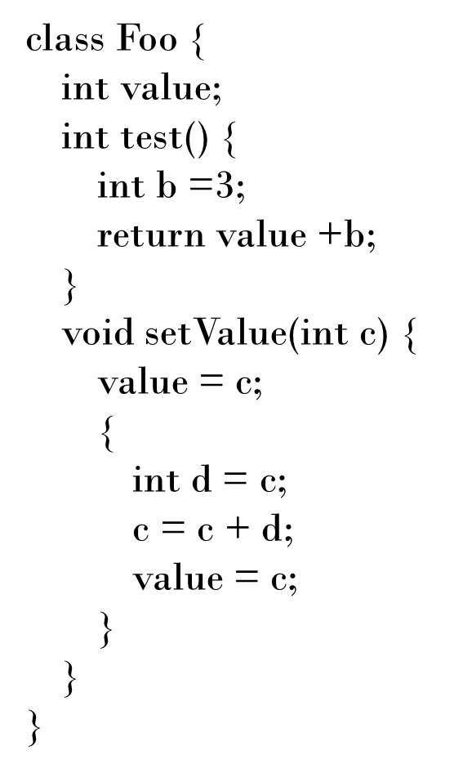
(Foo)
symbol | kind | type | attributes
value | field | int | …
test | method | ->int | …
setValue | method | int->void | …
(test)
(setValue)
symbol | kind | type | attributes
b | var | int | …
symbol | kind | type | attributes
c | var | int | …
symbol | kind | type | attributes
d | var | int | …

Slide 24
(Foo)
symbol | kind | type | attributes
value | field | int | …
test | method | ->int | …
setValue | method | int->void | …
(test)
(setValue)
symbol | kind | type | attributes
b | var | int | …
symbol | kind | type | attributes
c | var | int | …
(block1)
void setValue(int c){
value = c;
{
int d = c;
c = c + d;
value = c;
}
}
symbol | kind | type | attributes
d | var | int | …
lookup(value)

Slide 25
(Foo)
Error!
symbol | kind | type | attributes
value | field | int | …
test | method | ->int | …
setValue | method | int->void | …
(test)
(setValue)
symbol | kind | type | attributes
b | var | int | …
symbol | kind | type | attributes
c | var | int | …
(block1)
void setValue(int c){
value = c;
{
int d = c;
c = c + d;
myValue = c;
}
}
symbol | kind | type | attributes
d | var | int | …
lookup(myValue)

